Slide 1

Baseball Pitch Analysis
Created by: Evan Haines, Chris Nicknish, Kaleb Sailer

Slide 2
Proposed Analysis
Research Question: How do different variables influence the likelihood of an umpire calling a pitch a ball or strike?
Importance:
Measuring umpire accuracy
Team game planning
Knowing what pitches out of the zone are more likely to be called a strike
Knowing what pitches in the zone are more likely to be called a ball

Slide 3
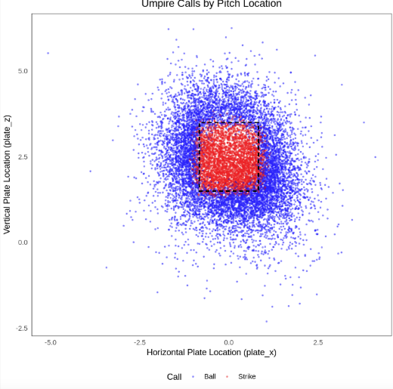

Data Overview
Size: 25000 rows and 113 columns
Target Variable: call (0 = ball, 1 = strike)
Preprocessing Steps:
Converted text labels to binary
Imputed missing values
Normalized numeric variables
Created dummy variables for categorical variable

Slide 4

Modeling Approach
Model Used: Logistic Regression
Train/Test Split: 80/20 with stratification on the target
Recipe Steps: Imputation, encoding, normalization
Error Handling:
Try-catch blocks during model fitting and plotting
Logging messages or fallback behavior if errors occurred

Slide 5
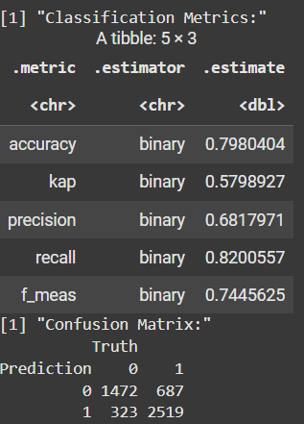
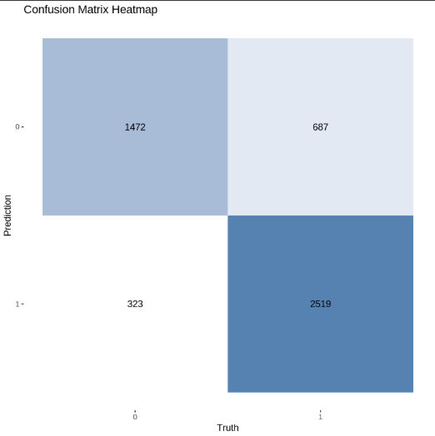
Regression Results

Slide 6
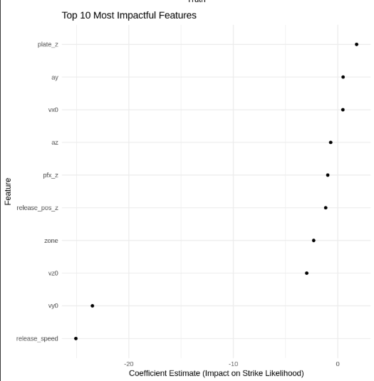
Feature Importance
Key Observations:
plate_z had the largest positive impact — pitches higher in the
zone more likely called strikes.
release_speed and vy0 had large negative coefficients, meaning
faster or steeper arm angles were less likely called strikes (possibly due
to perceived difficulty or misreading).
Some variables with near-zero coefficients have minimal impact
on prediction.

Slide 7
Data limitations
Only one model type used
Logistic regression assumes linear relationships
Some features may be correlated
Could improve with more advanced models
Some other features could provide additional insights (Umpire-specific differences, game conditions like weather, etc.)

Slide 8

Final Insights
Model performed well overall:
Accuracy: 79.8%
Precision: 68.2%
Recall: 82%
F-1: 74.5%
Most impactful features:
Vertical location (plate_z)
Velocity components
Spin-related metrics
Human element still matters:
Despite good prediction, umpire judgment likely adds noise — suggests opportunity for fairness tools or automated systems.
Error handling added robustness:
Our model includes error catching in key stages (fitting, plotting), ensuring it runs even with bad input or missing data.

